Slide 1

Ethics & Responsible AI
Building ethical awareness and responsible practices for human-AI collaboration in the workplace.

Slide 2
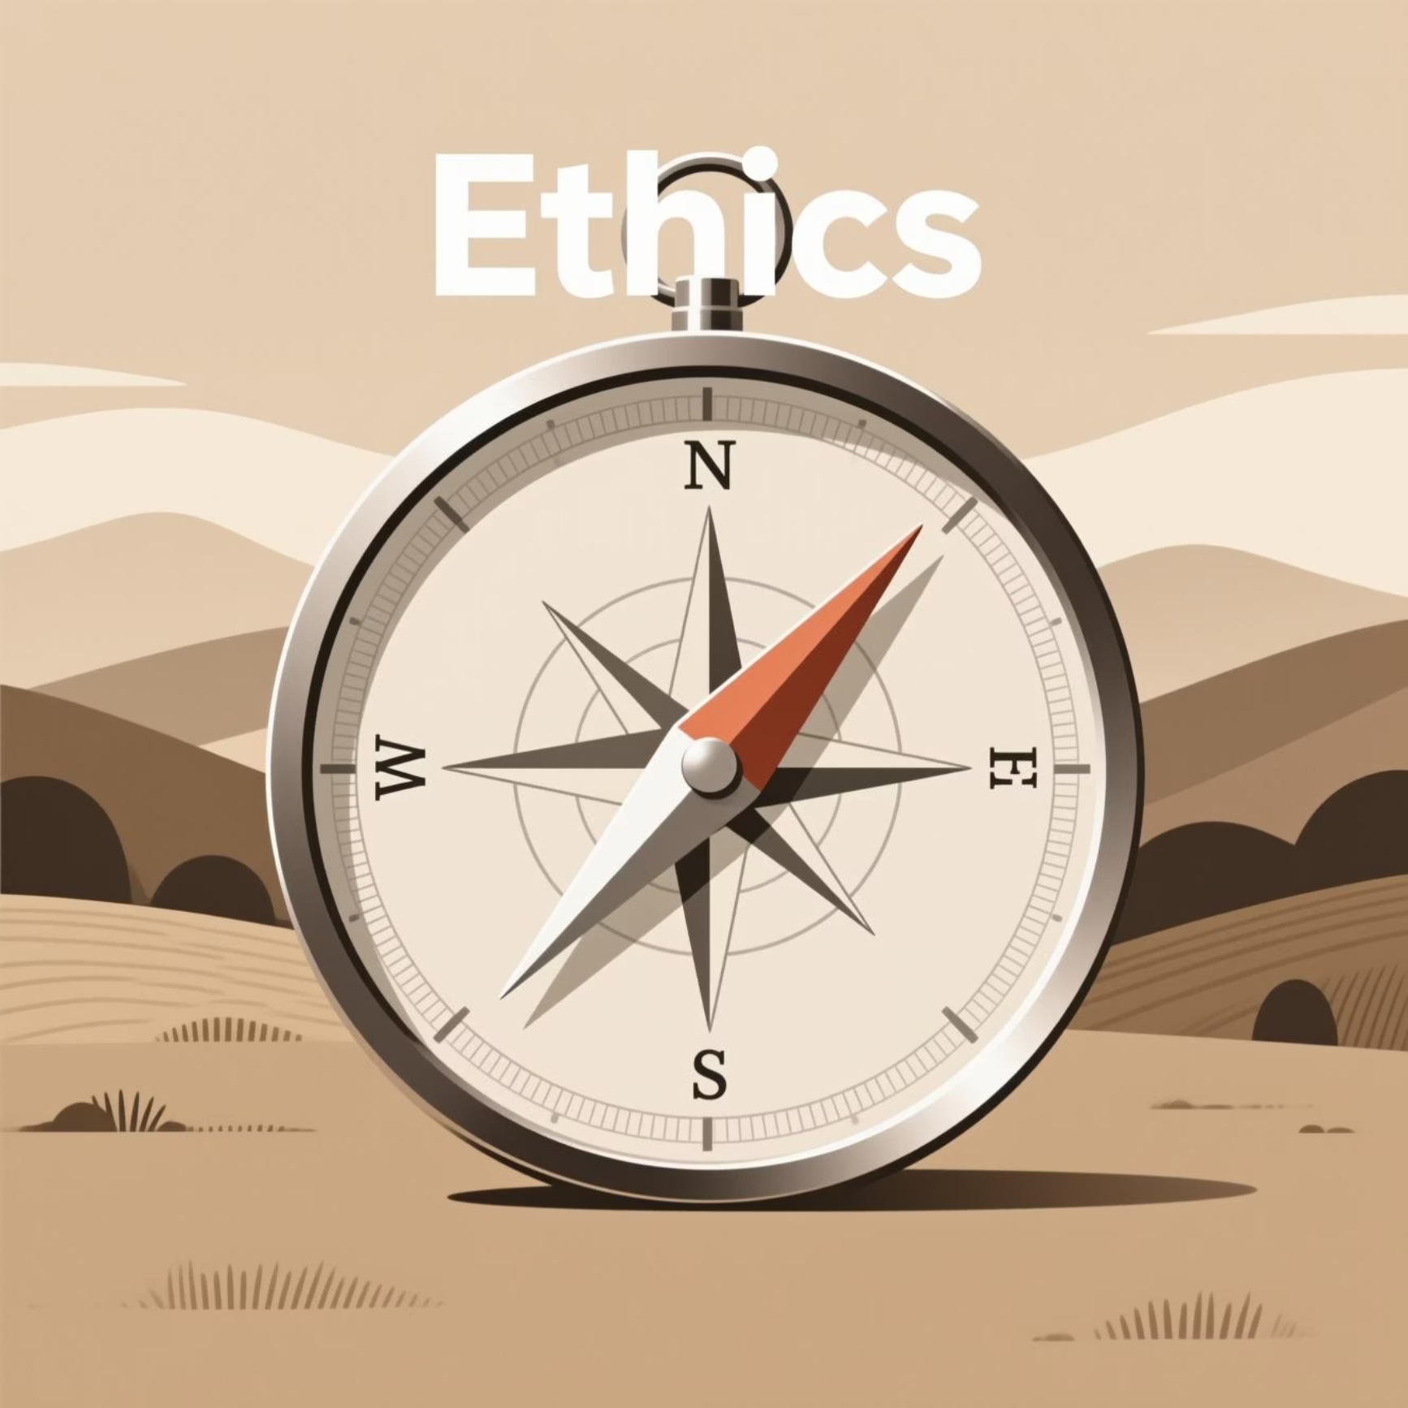
Module Overview
Duration
60 minutes of interactive learning
Core Focus
Understanding ethical challenges, identifying bias and privacy risks, and developing responsible AI collaboration strategies
01
02
03
Identify Challenges
Understand Risks
Explore Solutions
Recognize ethical issues in AI systems
Examine bias and privacy concerns
Develop responsible collaboration strategies

Slide 3

Bias in AI: Understanding the Problem
AI systems learn from human-generated data, which means they can inherit and amplify existing biases present in our society. This creates real risks across critical decision-making contexts.
Hiring & Recruitment
Law Enforcement
Resume-screening AI may favor candidates similar to those previously hired, unintentionally disadvantaging women or minority groups who weren't well-represented in historical data.
Predictive policing systems might disproportionately target neighborhoods historically over-policed, perpetuating cycles of inequality rather than promoting fair justice.
Healthcare Diagnostics
Financial Services
Algorithms trained primarily on one demographic may perform poorly for others, leading to misdiagnoses or inadequate care recommendations.
Credit scoring and lending algorithms may deny opportunities to qualified applicants based on biased historical patterns in approval data.
Discussion Prompt: "Why can AI trained on biased data be harmful? Can anyone think of a real-world consequence you've heard about?"
AI reflects the world it learns from—ethical awareness and careful oversight are essential to prevent harm.

Slide 4

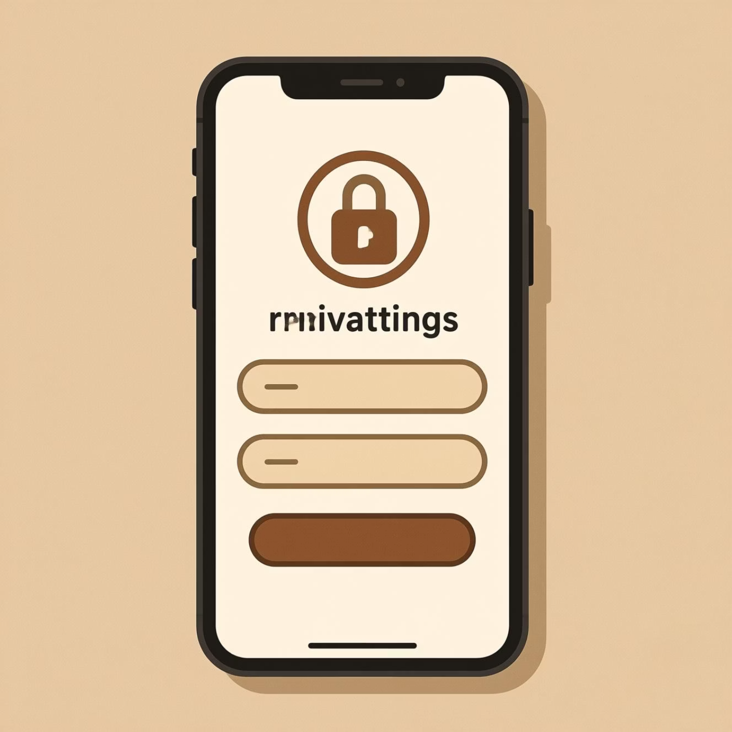
Privacy & Data Awareness
AI tools often collect, analyze, and store personal data to improve performance. Responsible AI use requires understanding what happens to your information.
Critical Questions to Ask
What data is being collected?
Where is it stored and who can access it?
Voice recordings, location history, activity patterns, personal preferences, and even biometric information
Cloud servers, third-party processors, or partnered organizations may all have varying levels of access
How is it used or shared?
Training future models, personalized advertising, product improvement, or potentially sold to partners
Voice Assistants
Mobile Apps
AI Platforms
Recording conversations for feature improvements and personalization
Tracking location, activity, or habits for recommendations
Storing user content including writing, images, and prompts
Awareness of privacy and data practices is essential for safe and responsible AI use.

Slide 5



Human + AI Collaboration
The most effective approach combines human strengths with AI capabilities, creating outcomes better than either could achieve alone.
Humans Provide
AI Provides
Judgment & Decision-Making
Speed & Scale
Critical thinking and weighing complex factors
Processing vast amounts of information quickly
Empathy & Ethics
Pattern Recognition
Understanding human impact and moral reasoning
Identifying trends in complex data sets
Context & Creativity
Efficiency
Nuance, imagination, and innovative thinking
Automating repetitive or time-consuming tasks
Think of it this way: AI is a super-powered assistant—it can crunch numbers or generate options quickly, but humans decide the meaning, ethics, and priorities.

Slide 6



Activity: Debate
Should AI ever make life-changing decisions without a human involved?
Split Into Teams
Brainstorm Points
Debate
Divide into "Yes" and "No" groups
Develop 2–3 supporting arguments
Share perspectives for 5–10 minutes
Debrief Questions
What risks arise if humans are removed from decision-making entirely?
Are there situations where AI might actually improve outcomes?
How does human-AI collaboration reduce errors or potential harm?
Consider real-world examples: medical diagnoses, autonomous vehicles, financial decisions, or criminal justice applications. What role should humans play in each scenario?

Slide 7
Facilitator Speaker Notes
Bias in AI Discussion
1
"AI can only be as fair as the data it learns from. Historical biases, incomplete data, or underrepresented voices can all lead to unfair outputs."
2
Privacy Conversation
Key questions to pose: Who created the data? Whose perspectives are missing? Could the AI make unfair decisions?
"Many AI tools use your personal data to improve performance. Being aware of what is collected, stored, or shared is part of responsible use."
Collaboration Emphasis
3
Optional discussion: "Is it okay for an AI app to access your location or medical data? Why or why not?"
"Humans remain responsible for ethical decisions. AI can assist, but human judgment, context, and empathy are irreplaceable."
Reinforce: Responsible AI = human oversight + AI efficiency
4
Debate Facilitation
"Use this debate to critically evaluate when AI should or shouldn't have autonomy in important decisions."
Encourage: Evidence-based reasoning and consideration of real-world implications
Core Message: AI is powerful, but ethical awareness is critical. Bias, privacy, and human oversight must guide AI use. Responsible AI is collaborative, transparent, and accountable.

Slide 8
Module Summary
By completing this module, learners will understand the essential principles of ethical and responsible AI use in professional contexts.
AI Can Reflect Biases
Data Privacy Matters
Understand how AI systems inherit and amplify biases present in training data, potentially causing harm across hiring, healthcare, law enforcement, and financial services.
Recognize the importance of understanding what personal data AI tools collect, where it's stored, who accesses it, and how it's used or shared.
Human Oversight is Essential
Collaboration Creates Value
Appreciate that ethical AI use requires human judgment, empathy, and decision-making authority—especially for life-changing decisions.
Leverage the best of both worlds by combining human judgment, context, and creativity with AI's speed, pattern recognition, and efficiency.
Responsible AI combines human judgment with AI capabilities to maximize benefits and reduce harm.

